Slide 1

POULTRY SCIENCE:
Introduction
Unit 2

Slide 2
Poultry Science:
Introduction
Unit 2: Segment 1
Terminology & History

Slide 3
Terminology
Domestication
When people take wild animals or plants and breed them over multiple generations such that their characteristics are meeting human needs.
Ornithology
The study of birds.
Zoology
The study of animals.

Slide 4


Terminology
Avian – Relating to, or derived from birds
Poultry – Domesticated birds for the purpose of their meat and eggs for human consumption and use.
Raptors – Birds of prey: hawks, eagles, owls, etc.
Notes:
Terminology tree

Slide 5
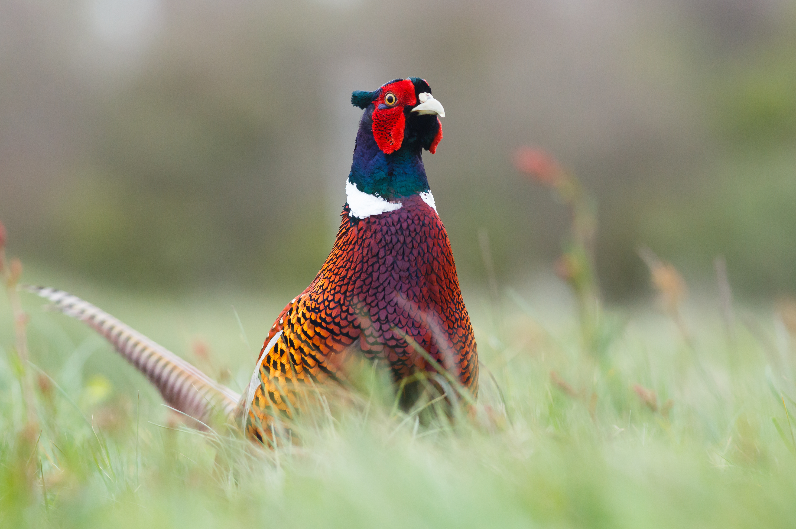
What birds are considered to be “poultry”?
Poultry
Chickens
Turkeys
Quail
Pigeons
Ostriches
Emus
Game fowl, peafowl, waterfowl

Slide 6
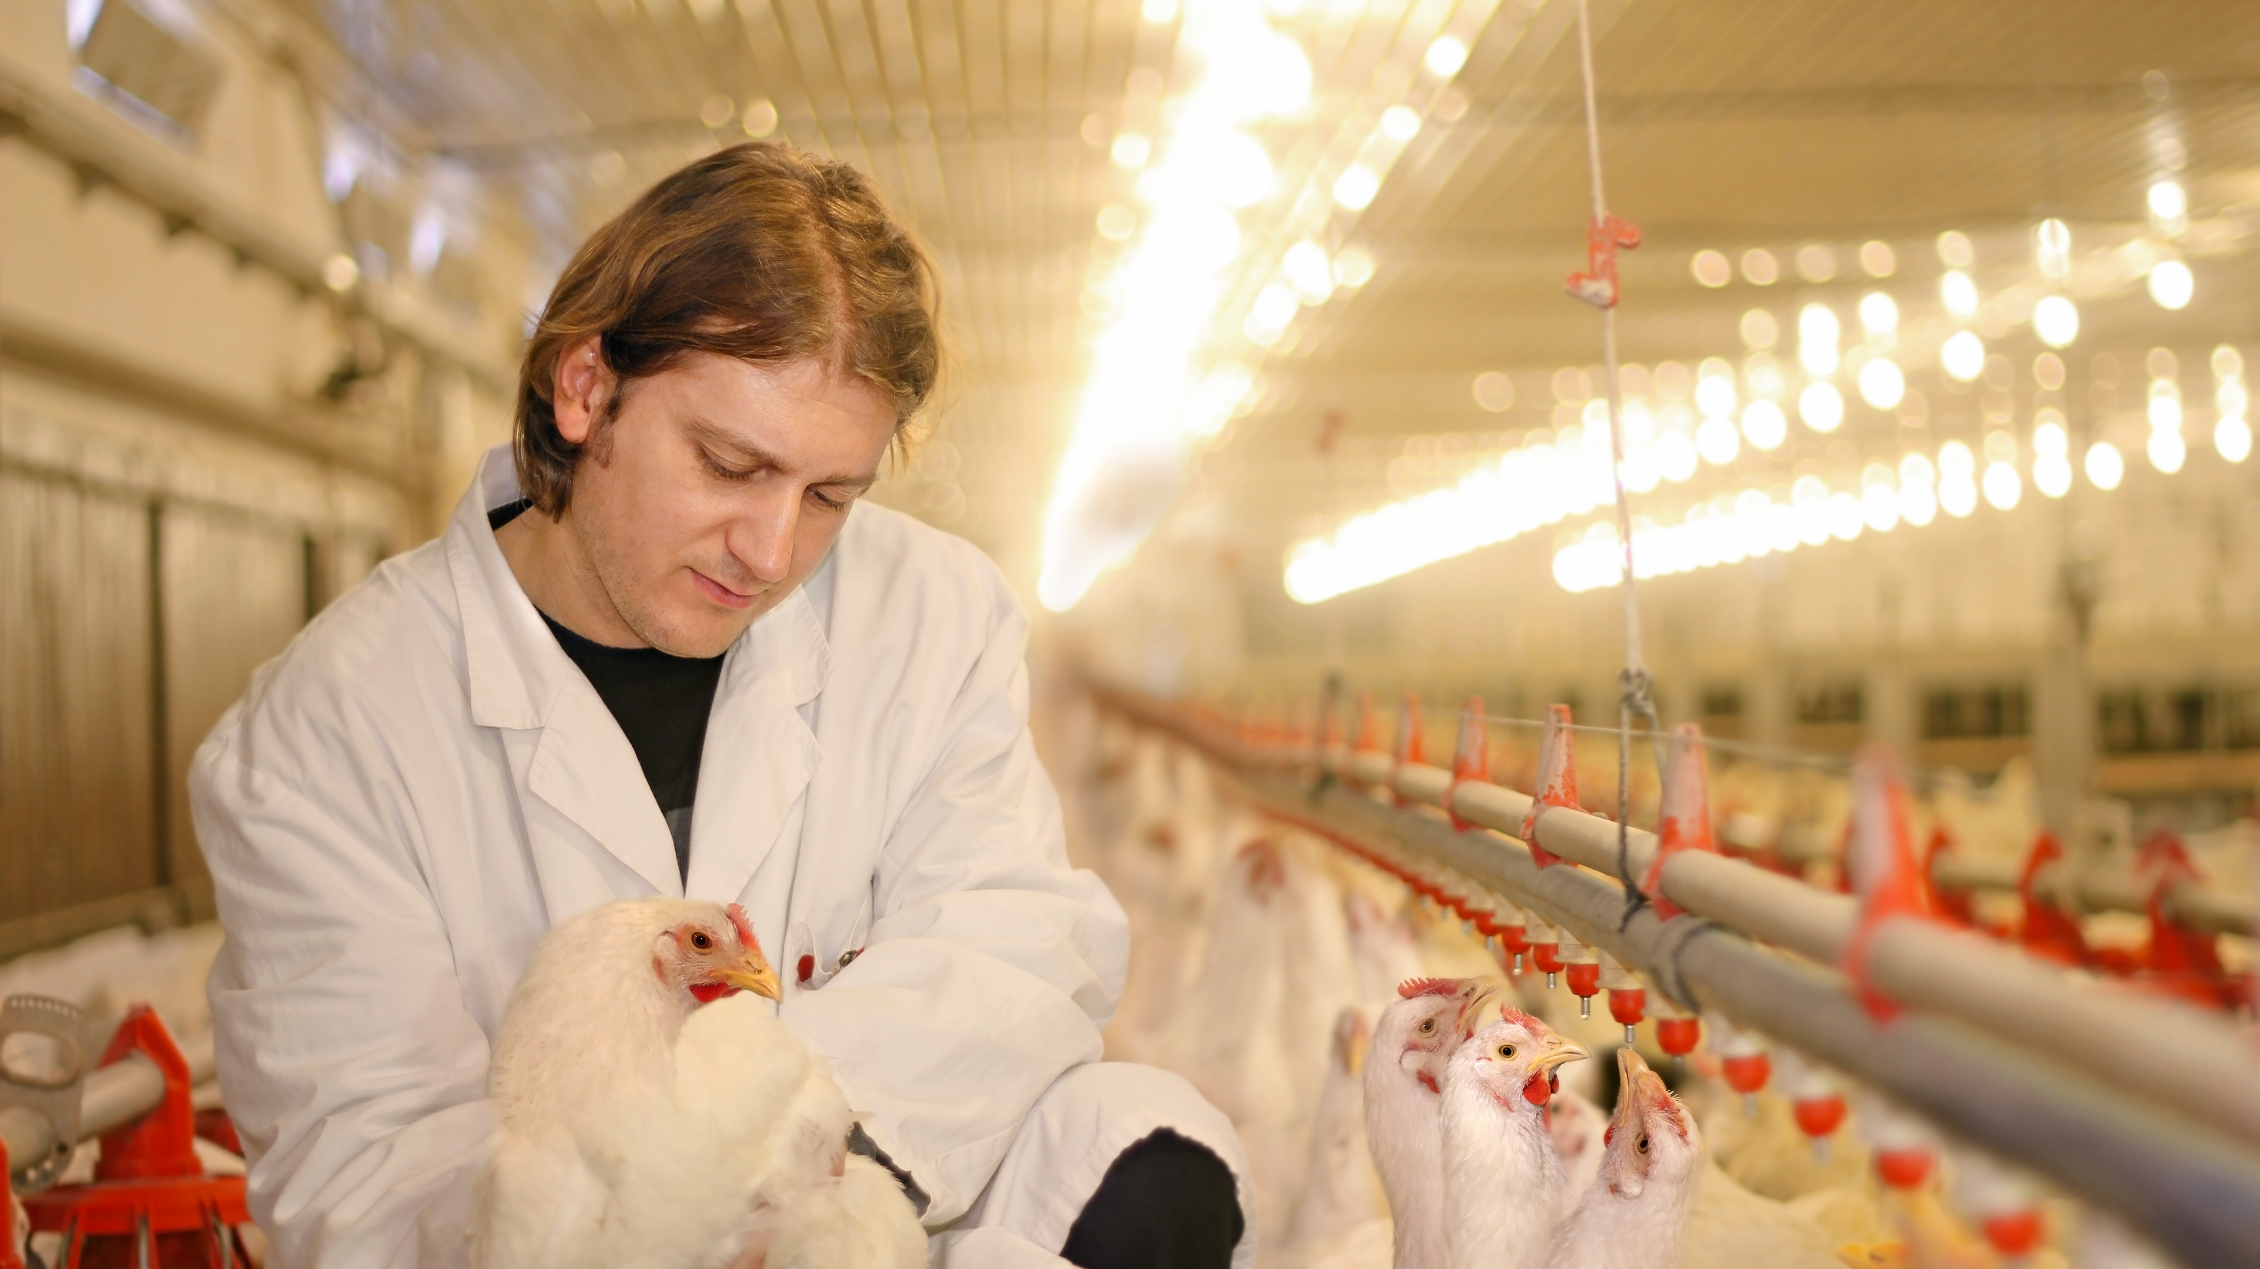
What is “Poultry Science”?
The multidiscipline study of the principles and practices of rearing live poultry, slaughtering poultry, and business management associated with a commercial poultry enterprise.

Slide 7
Careers in Poultry Science
Veterinarian
Economist
Environmentalist
Engineering
Food Science
Business Management
Geneticist
Nutritionist
Physiologist
Microbiologist
Parasitologist
Animal Behaviorist
It’s more than clucks and ducks!

Slide 8
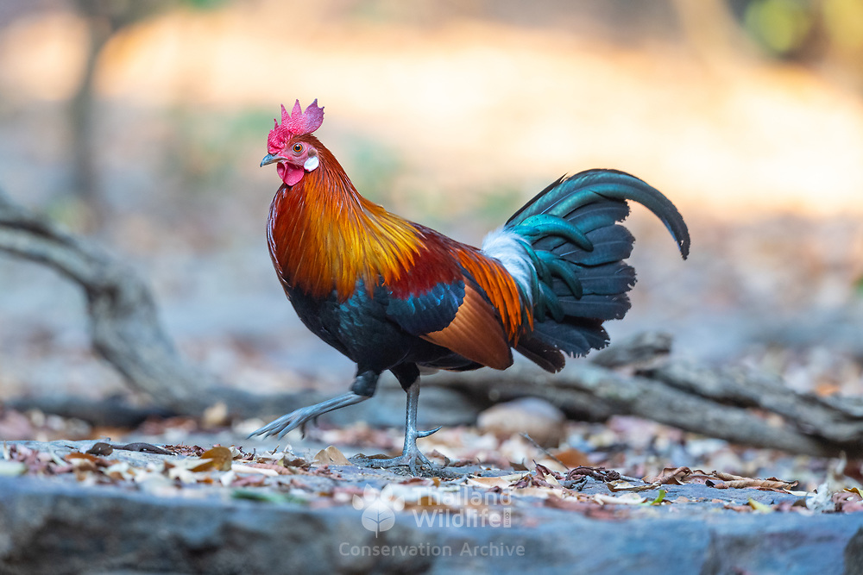
Domestication of Chickens
Domesticated for food (eggs & meat), religious/ceremonial purposes, and/or for cockfighting
Domesticated from junglefowl
  Red Junglefowl (Gallus gallus)
  Endemic of Southeast Asia
  Approx. 10,500 years ago
Red Junglefowl (Gallus gallus)

Slide 9
Chickens in the United States
First brought to the Americas in 1607 by the English
  1609: Colonists establish Jamestown
  1620: The Pilgrims brought domestic fowl to America
Cock fighting was a popular use for male chickens in England and America until outlawed and is the reason chickens were first domesticated thousands of years ago.

Slide 10
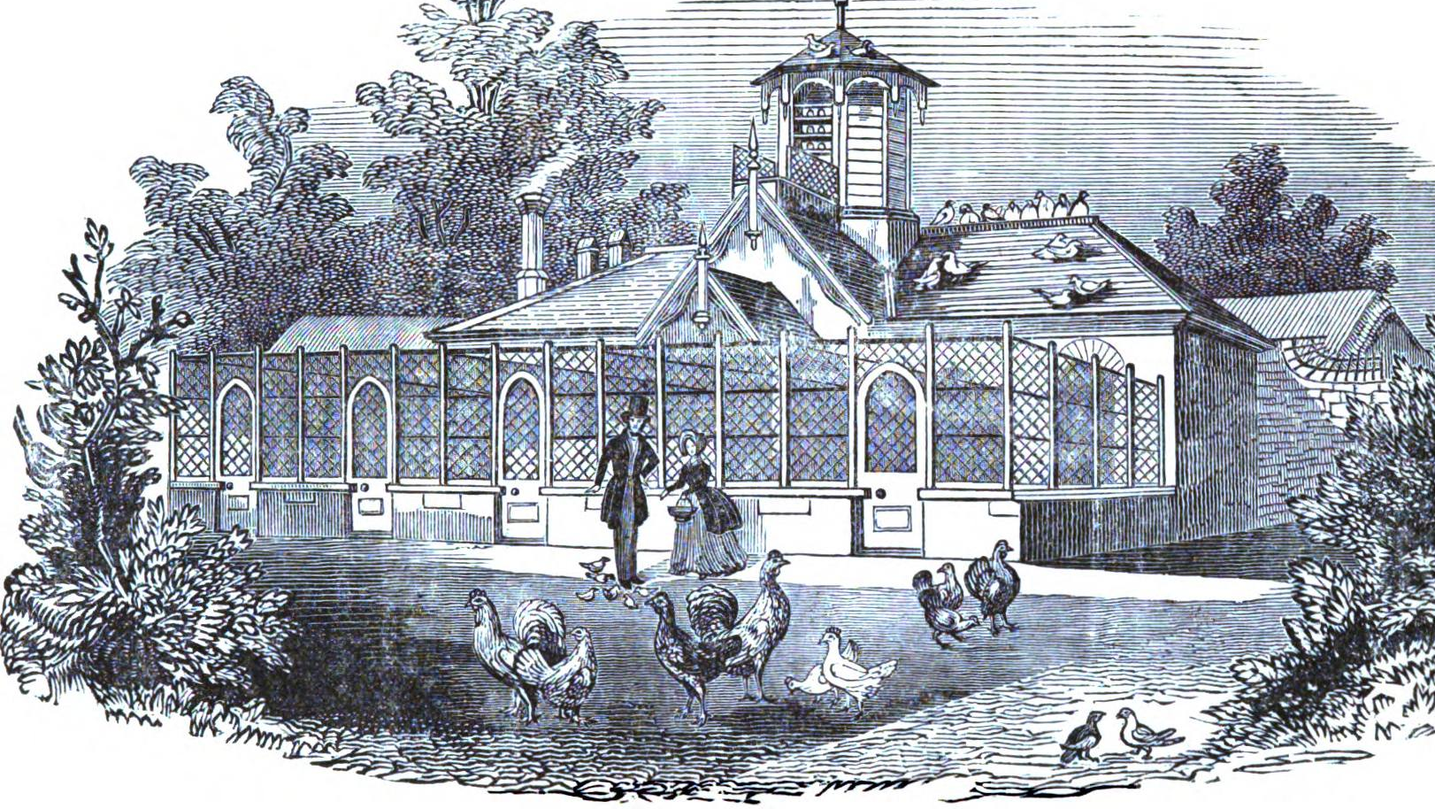
Fit for a Queen
Queen Victoria of England and China were at odds in 1842
China brings the Queen a few buff-colored Cochins as a peace offering, which the Queen found to be beautiful, exotic creatures!
Victoria grows her bird collection, inspiring her people to want to follow in her footsteps, thus sparking Poultry Shows which still take place today.
Queen Victoria’s Poultry House

Slide 11
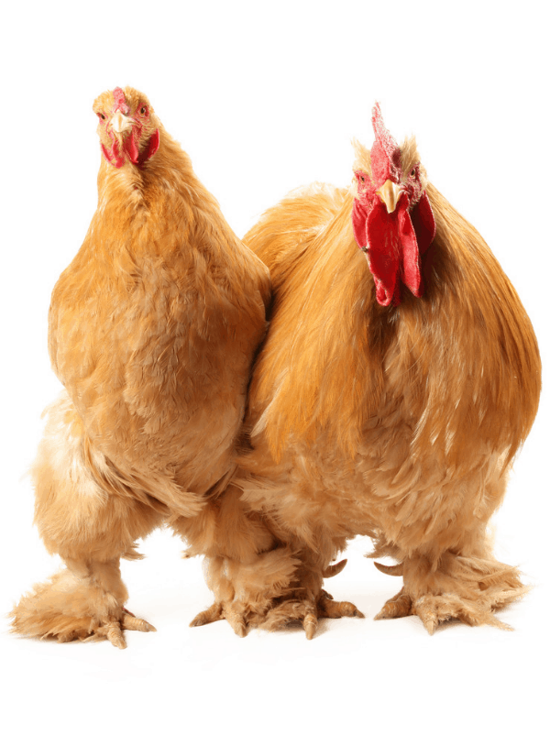
“Hen Fever”
After Queen Victoria sparked the poultry fad in England, a world-wide movement took place that spread the once-stationary Cochin breed to become a trans-continental breed.
Once it hit the U.S., it became known as “Hen Fever”, but by 1855 it slowed due to how expensive it was to purchase the Cochins and other poultry breeds.
Buff Cochin Hen & Rooster

Slide 12
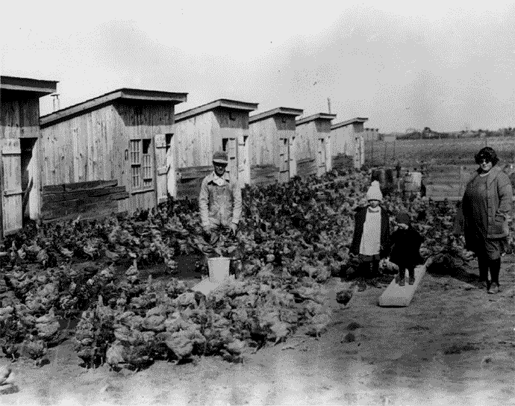
The Mother of the Poultry Industry
Cecile (Wilmer) Steele of Delaware decided to order a few backyard birds from a Sears catalog in 1923.
Rather than receiving 50 like she ordered, she got 500 birds!
387 survived, and after 16 weeks, she sold them for what today would equal approximately $7/lb.
By 1925, Mr. Steele had quit his job to work for his wife.
Within 5 years, there were ~500 growers in the area, thus beginning large-scale poultry production!
The Steele Family

Slide 13
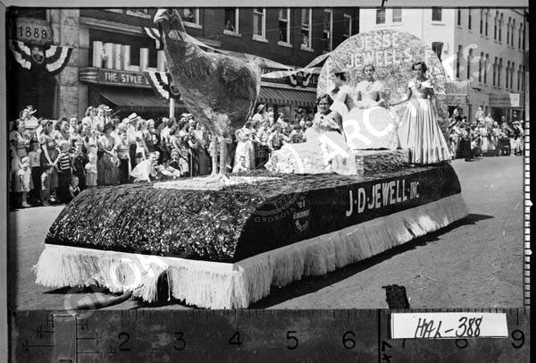
The Father of the Poultry Industry
Jesse Jewell – managed family’s feed and seed store in Gainesville, GA.
Boll Weevil decimated cotton, so South GA turned to peanuts, tobacco, and other row crops to recuperate while North GA turned to poultry.
He sold chicks from the store, gave the feed on credit, thus beginning vertical integration.

Slide 14
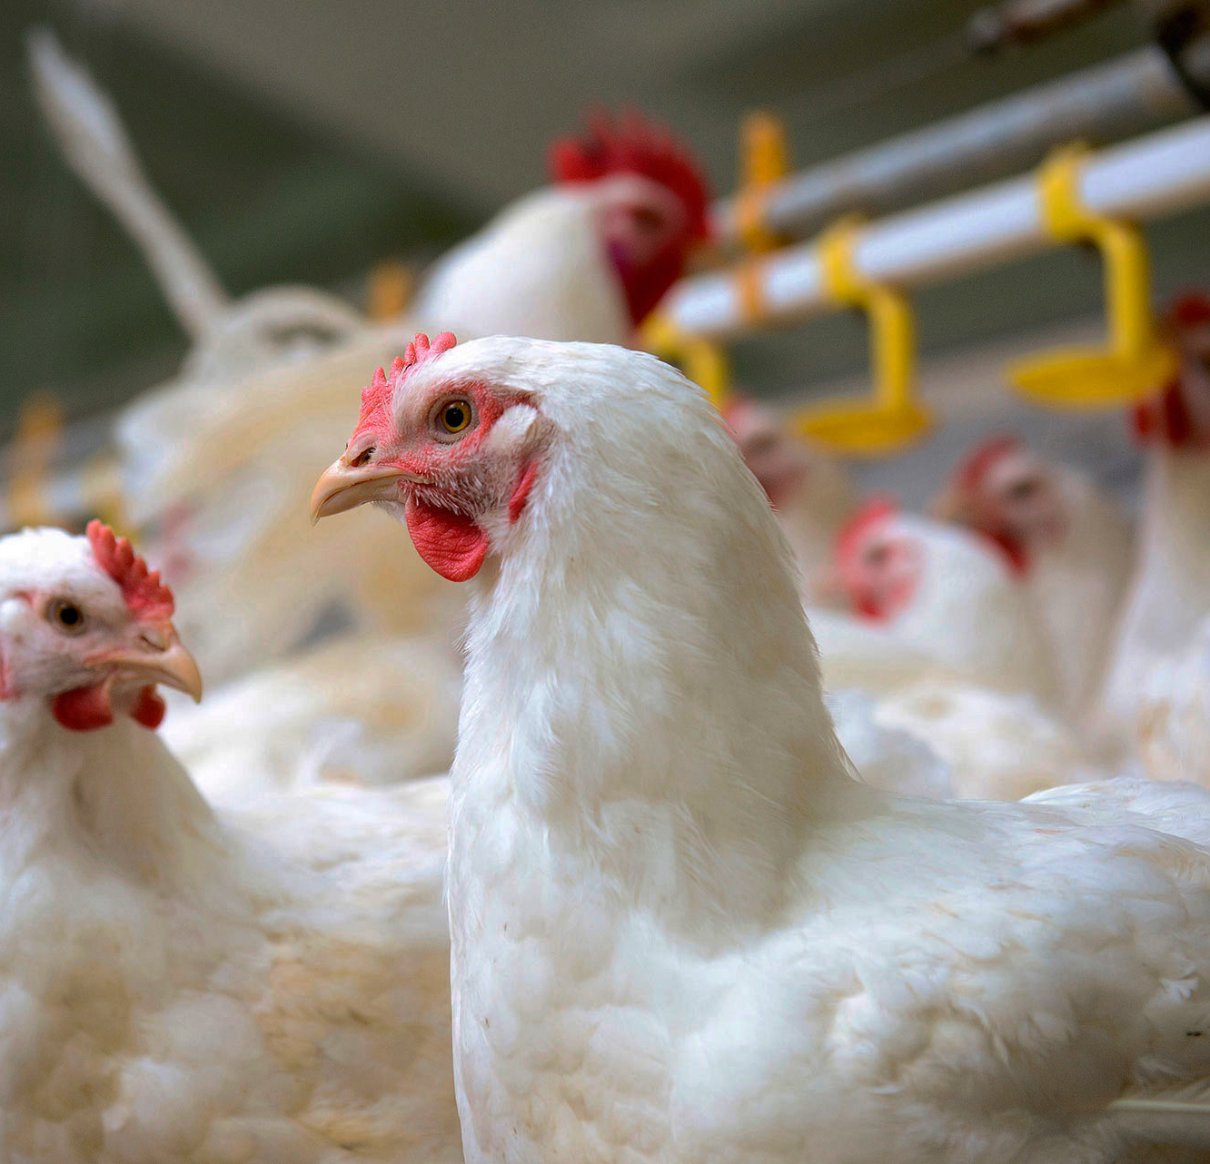
Poultry Capital of the World
Within 20 years of Jesse Jewell’s new business venture, Georgia took the crown as the #1 poultry producing state in the nation, where it remains today.
If Georgia were its own country, it would be #7 in the world in poultry production!
Georgia Poultry Federation, 2019

Slide 15
Poultry Science:
Introduction
Unit 2: Segment 2
Modern Poultry Industry

Slide 16



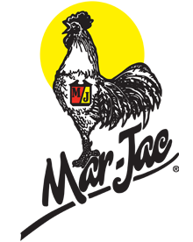



Vertical Integration
Process in which a single company owns 2+ stages in the supply or value chain.

Slide 17
Why Vertical Integration?
The vertical integration of the U.S. poultry industry has many advantages over an open production agriculture system that makes it more efficient:
  Profit: Single business entity allows for collective profit management
  Transaction: Reduced transaction costs
  Control: Improved management control
  Redundancy: Elimination of redundant services
  Bulk: Discounts for bulk purchases
  Technology: Economies of scale with size and funding for new technologies

Slide 18
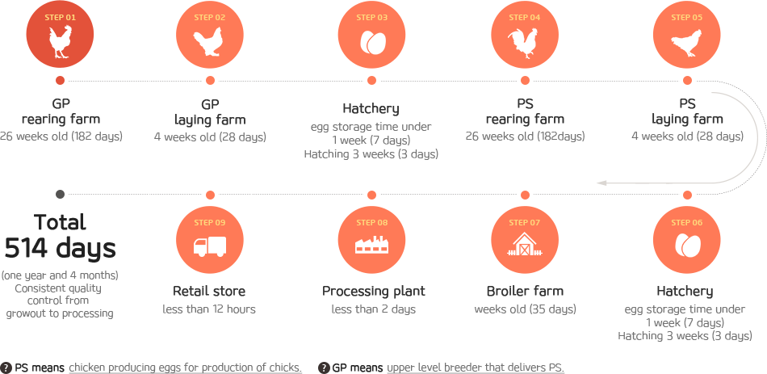
Vertical Integration Diagram

Slide 19

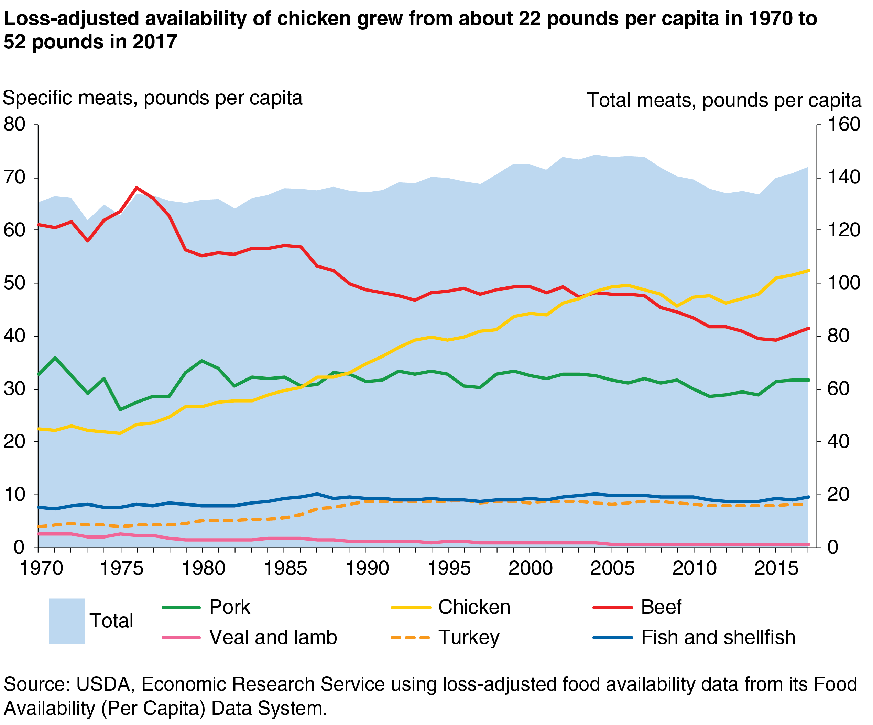
Chicken: America’s Favorite Food

Slide 20





2019 Top 5 Broiler Companies by Pounds Produced
1.) Tyson Foods
200 million pounds
2.) Pilgrim’s Pride
161 million pounds
3.) Sanderson Farms
90 million pounds
4.) Perdue Foods
5.) Koch Foods
61 million pounds
63 million pounds
WATT PoultryUSA, 2020

Slide 21
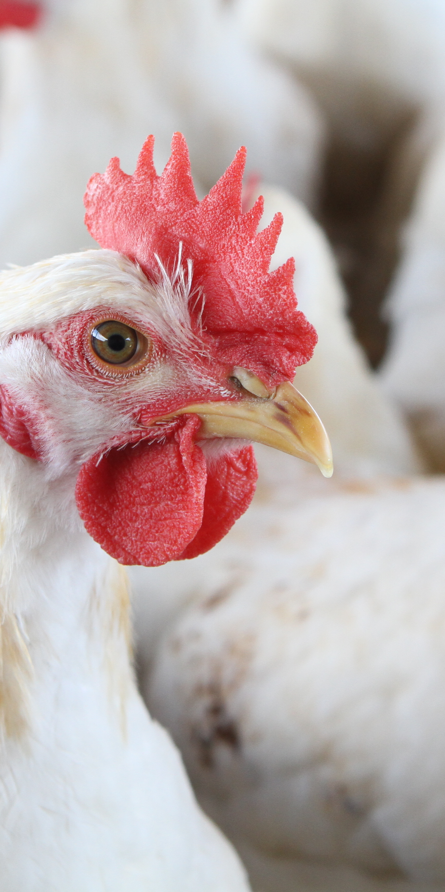
Who is doing the growing?
Approximately 25,000 family farms have production contracts with the poultry companies.
Roughly 95% of broiler chickens are produced on these farms, with the remaining 5% raised on company-owned farms or farms without contracts.

Slide 22
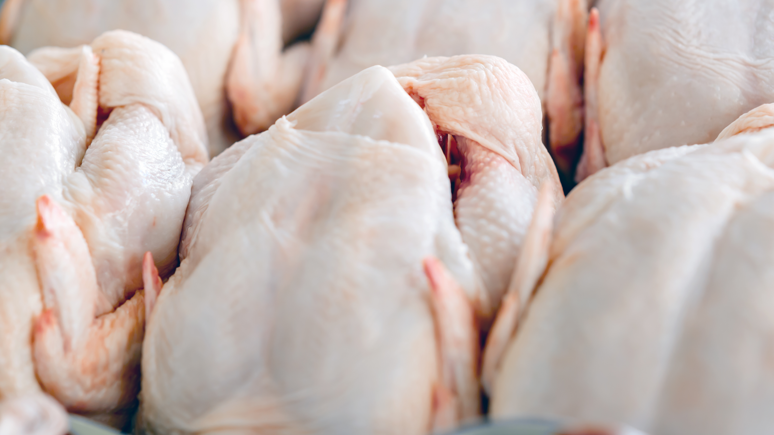
Does it all stay here?
The U.S. has the largest broiler chicken industry in the world with about 17% of production exported to other countries in 2018.
  Top 5 Export Destinations: Mexico, Canada, Taiwan, Angola, & Cuba
Americans consume more chicken than anyone else in the world – more than 93.5 lbs. per capita in 2018 – the #1 protein consumed in the U.S.

Slide 23
Poultry Science:
Introduction
Unit 2: Segment 3
Poultry in Georgia

Slide 24
Why is Georgia the Poultry Capital of the World?
You have to add up the value of every pound of cotton, plus every bushel of peanuts, pecans, corn and blueberries, plus every beef cow, dairy cow, horse and pig, plus everything grown in a commercial greenhouse, plus every log commercially harvested, plus every dollar generated by agri-tourism to meet the Farm Gate Value of Poultry and Eggs in Georgia!

Slide 25
On an Average Day in Georgia, We Produce…
31M
Pounds of Chicken
7.6M
Table Eggs
6.3M
Hatching Eggs
Georgia Poultry Federation, 2019

Slide 26
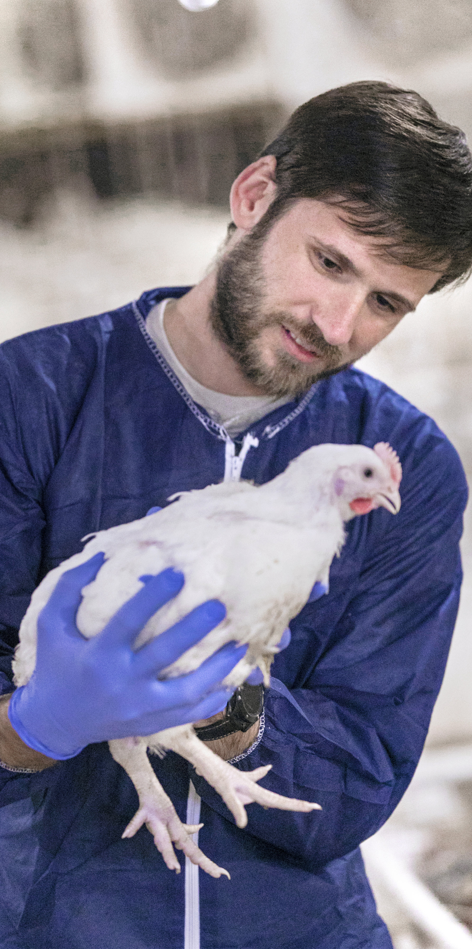
Economic Impact on Georgia
The jobs of approximately 183,000+ Georgians depend on the poultry industry directly or indirectly!
Georgia has 101 counties that produce more than $1M of poultry at the farm level.
The average broiler farm in Georgia can feed 7M people (the entire state of Washington) OR 19,400 people a meal/day for a year!
Georgia Poultry Federation, 2020

Slide 27

Annual Contribution to Georgia’s Economy
$47.08 Billion
Georgia Poultry Federation, 2020

Slide 28
Poultry Science
Curriculum References
Jessica Fife, UGA Dept. of Poultry Science Outreach Coordinator, UGA Dept. of Agricultural Leadership, Education, & Communication MAEE Candidate
Barry Croom, UGA Dept. of Agricultural Leadership, Education, & Communication Professor
Ashley Yopp, UGA Dept. of Agricultural Leadership, Education, & Communication Assistant Professor
Georgia Agriculture Education
Andrew Benson, UGA Dept. of Poultry Science Assistant Professor
Brian Jordan, UGA Dept. of Poultry Science Assistant Professor, UGA College of Veterinary Medicine Assistant Professor
University of Arkansas Bumpers College of Poultry Science – Poultry Science Dual Curriculum Course
Julia Gaskin, UGA Dept. of Crop and Soil Sciences Sr. Public Service Associate
Glendon Harris, UGA Dept. of Crop and Soil Sciences Professor & Extension Agronomist
Brian Kiepper, UGA Dept. of Poultry Science Associate Professor
Claudia Dunkley, UGA Dept. of Poultry Science Public Service Associate
Casey Ritz, UGA Dept. of Poultry Science Professor
USPOULTRY & USPOULTRY Poultry Science Curriculum
Tom Tabler, Mississippi State University Department of Poultry Science Extension Professor
Jacquie Jacob, University of Kentucky
Jeanna Wilson, UGA Dept. of Poultry Science Professor
Kelly Sweeney, UGA Dept. of Poultry Science Ph.D Candidate
Merck Veterinary Manual
University of Maryland Extension
Poultry Hub
Brian Fairchild, University of Georgia Department of Poultry Science Professor
Centers for Disease Control
National FFA Organization

